Slide 1




WELCOMEEEEEEEEEEEEEEEEEEEEEEEEEEEEEEEEEEEEEEEEEEE

Slide 2


In this guff gaffs, we will look at components from a consumer/ enthusiast POV rather than the designer or engineer’s POV which you have been doing from the day you join an engineering college.
The points we elaborate on are focused on majority of user’s demands so don’t be sad If you don’t see components that exist and we didn’t mention.

Slide 3

SOME initial questions
What your current CPU generation?
Why did you choose/ not choose to buy GPU?
What’s your screen type(IPS, OLED or TN)?
Do you need an SSD, a RAM upgrade, or an entire PC change for making your PC faster?
Would you choose MAC or Windows?
If you know the answers for most of these questions with logic and good explainable reasoning, then you wont learn much here.
This Photo by Unknown author is licensed under CC BY-SA-NC.

Slide 4




Start of the Formal Session

Slide 5
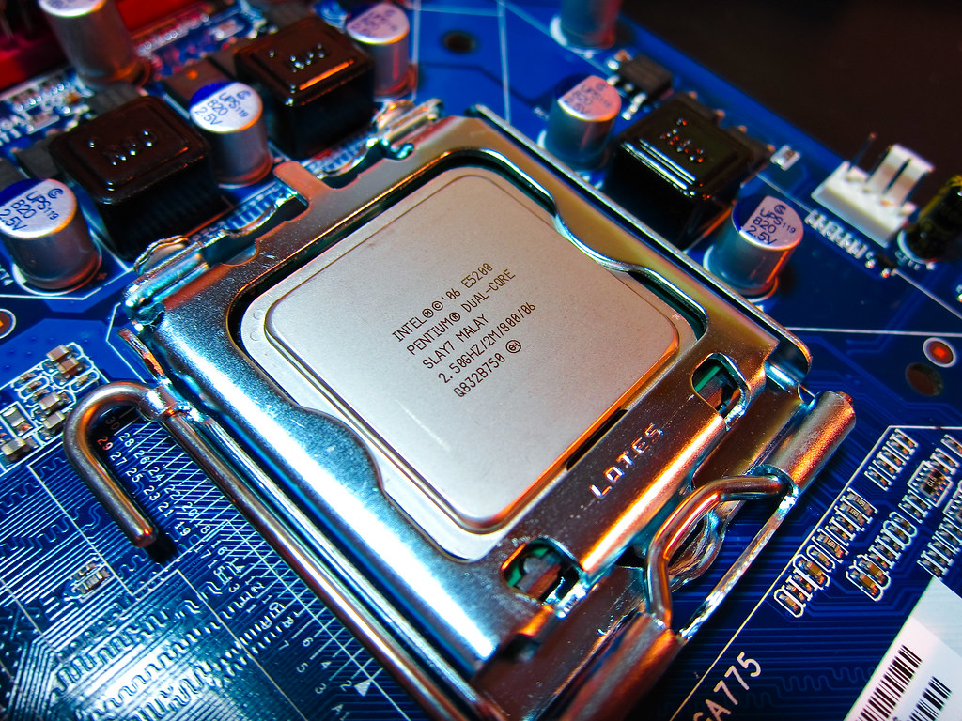
Lets start from the component that you have heard the most
CPU
This Photo by Unknown author is licensed under CC BY.

Slide 6
What to know about CPUs?
Price
Cores / Threads
Generation
Intel or AMD
Or Snapdragon
Efficiency
Their type (H, U or H, G, Core, or Ultra)
Cache
Frequency (the Burst vs Boost one)
Yes there are many more important points than these. But this much should suffice.

Slide 7
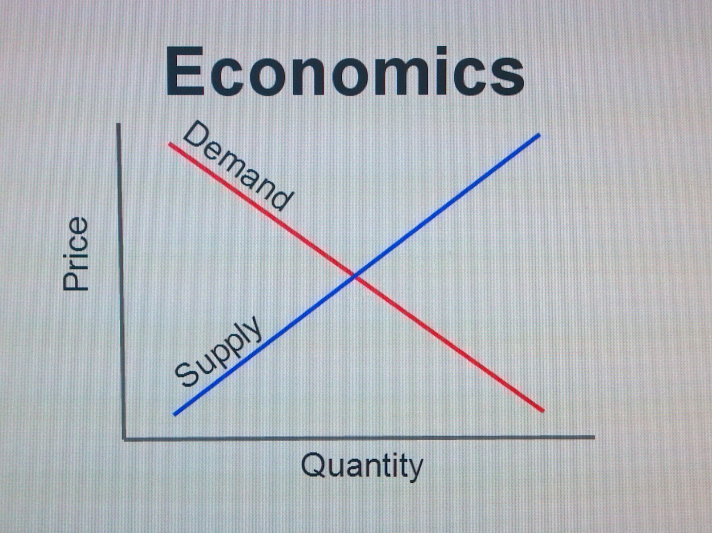
PRICE
Lets end this price discussion sooner than later. It’s the most fundamental part. You know why.
Fix nature of budget
Quality per cost is better than Quality itself
Price depends. On time. On site. On Seller. On location.
Not all expensive products are worth buying.
This Photo by Unknown author is licensed under CC BY.

Slide 8

Intel vs AMD vs Snapdragon
Intel vs AMD vs Snapdragon
Keep the Macbooks side for now.
In present
AMD -> Combined with AMD GPU can give good advantage -> Cheaper -> Runs cooler
Snapdragon -> Best Battery -> Lightweight -> Not available in Nepal.
Intel -> More cores -> Better single core performance -> Better for more technical works (scientific applications and all)
Answer: it depends on your workload
This Photo by Unknown author is licensed under CC BY-NC.

Slide 9
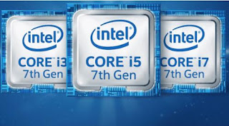
Range
Budget (I3 / R3) vs Midrange (I5 / R5) vs Flagship (I7 / R7) vs Overkill (I9 / R9)
X Plus, X Elite
I3 ( and similarly R3 as of AMD ) generally for non technical students who use computer just for 2-3 word and 2-3 tabs. No gaming no designing. There is hardly any flexibility on what you can do.
I5 ( similarly R5 or X Plus) is for everyone who wants a decent computer with good performance but don’t want to break the bank. Generally, all that you need if you are not hardcore user.
I7 ( similarly R7 or X elite ) is for everyone who are planning to use a PC very much. And have the budget. Will offer almost everything you will need. And the price to performance is good too.
I9 ( similarly R9 ) useful for certain user groups who need top of the line performance in certain apps. If you are a rich kid, you can buy. For most others its overkill. Less to gain more to spend.
This Photo by Unknown author is licensed under CC BY-SA-NC.

Slide 10
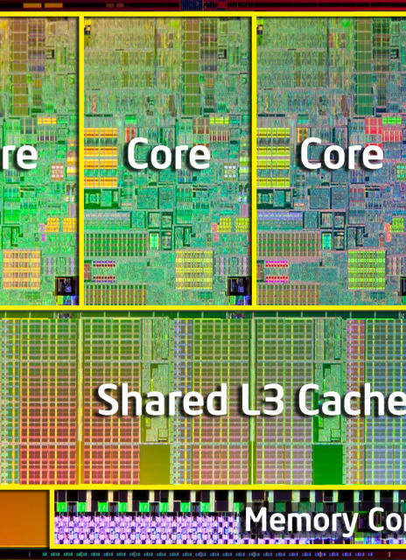
Cores / Threads
What is a core? (Alikati theoretical)
Higher core is “generally” better
Core Count generally doesn’t matter much above 8c/ 16t for home workloads.
Not all applications utilize this availability of many cores So, “single-core” performance matters a lot too.
Generally useful for multitasking. Other use cases might include running multiple VMs,
This Photo by Unknown author is licensed under CC BY-SA.

Slide 11
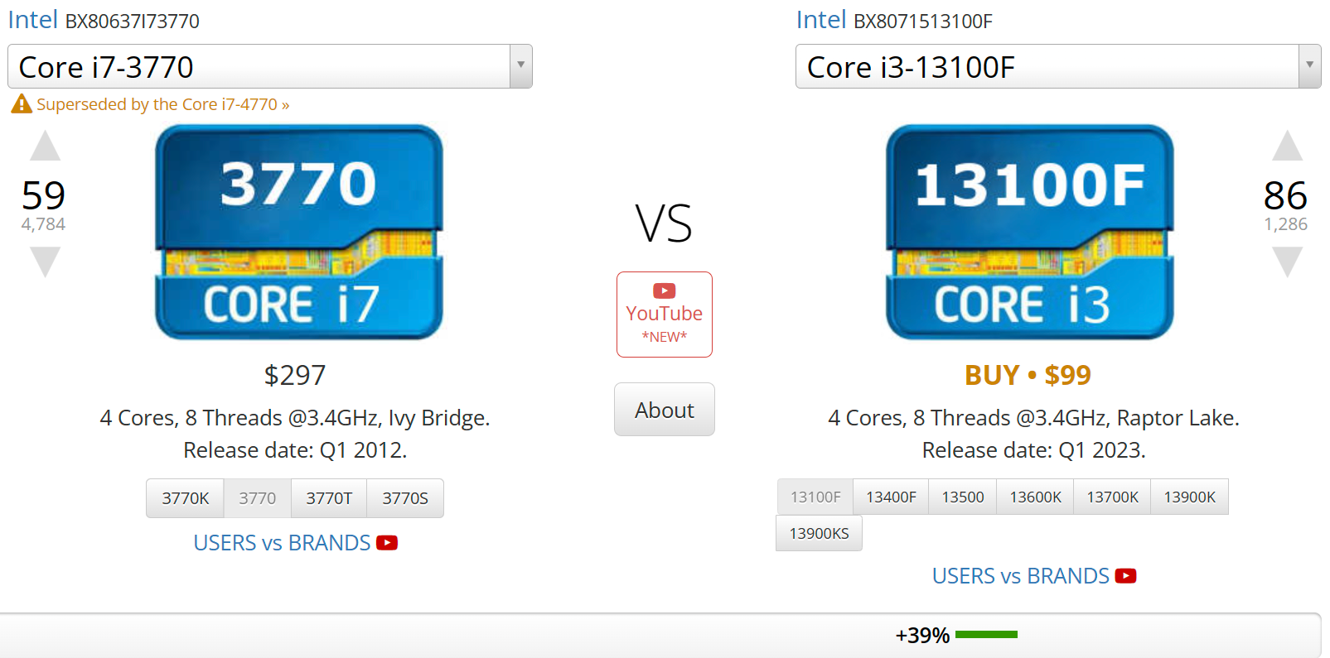
Generation
Year in which the processor was made
This changes everything about the range we discussed.
See how this i3 beats i7 processor, is cheap, and also consumes less power (77 vs 58) while having same core count and less frequency.

Slide 12

Benchmarks
As we saw in last slide, benchmarks give estimates.
But, be cautious.
Some benchmarks may perform better on certain hardware
More effective in comparing devices that were released near the same time
Doesn’t always show the real-world performance
This Photo by Unknown author is licensed under CC BY-NC-ND.

Slide 13
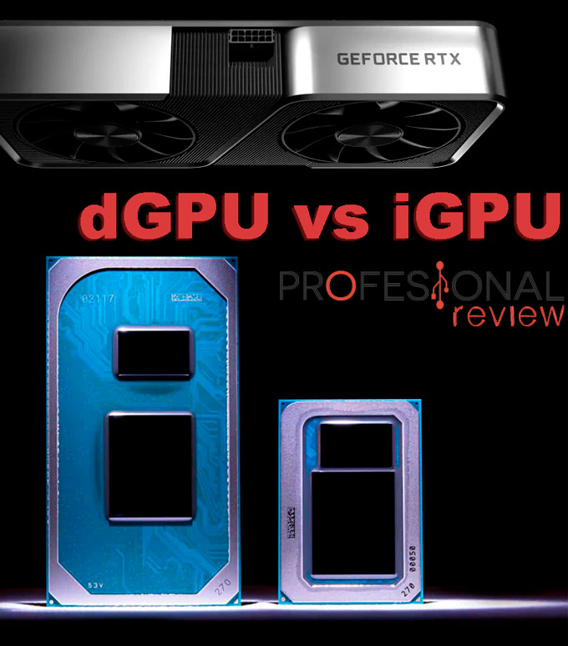
Type
With igpu or without? Intel xxxxF or xxxxG
Ultrabook processor or powerful processor? 5800U (15W) or 5800H (45W)

Slide 14
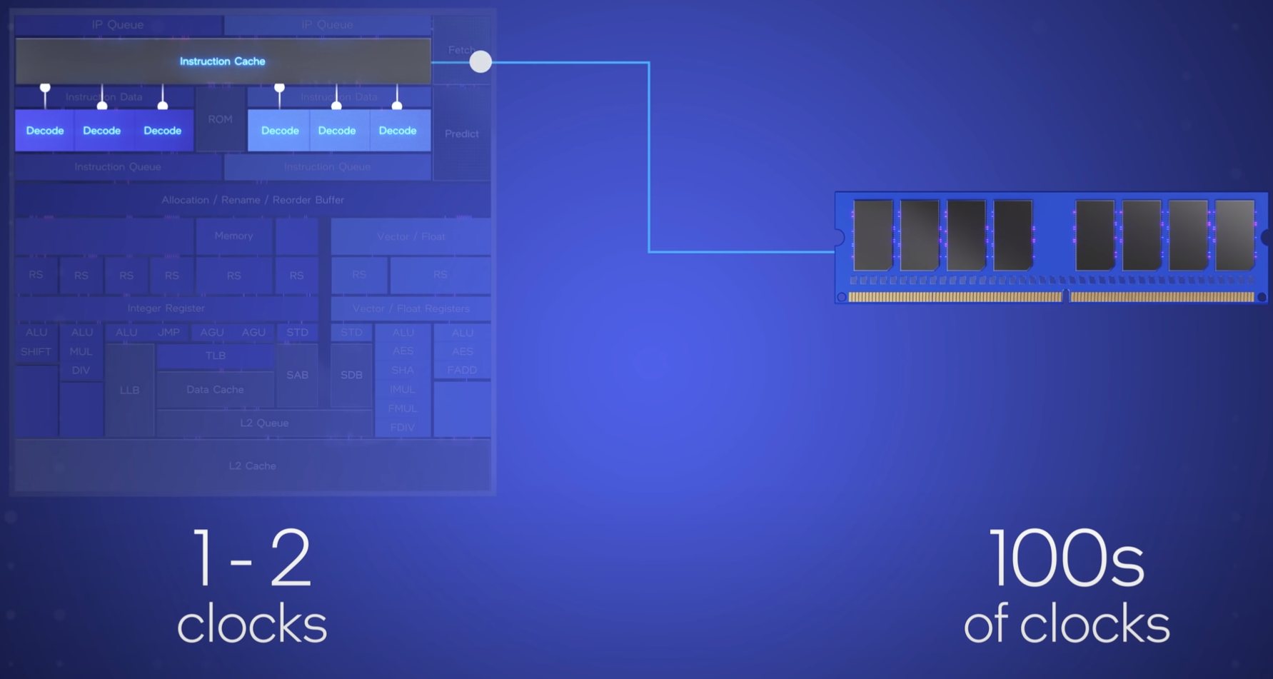
Cache
Whats a cache? Suitcase= Storage
Rack = RAM
Stand = Cache
Chair/ Bed = Register
Higher cache Better
L1 >= 256KB
L2 >= 1MB
L3 >= 8MB

Slide 15
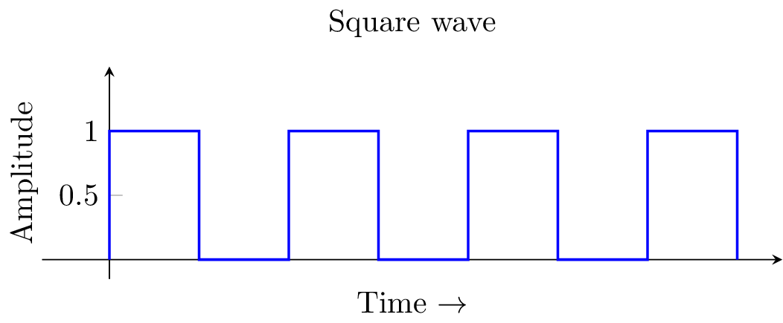
Frequency
Rate at which the CPU operates.
The higher the better
Burst/ Boost Frequency vs Base frequency
Yes, there are many more important points than these. But this much should suffice.
This Photo by Unknown author is licensed under CC BY-SA.

Slide 16
Practical Time
Benchmark Test
3d render Test
Browsing Test

Slide 17
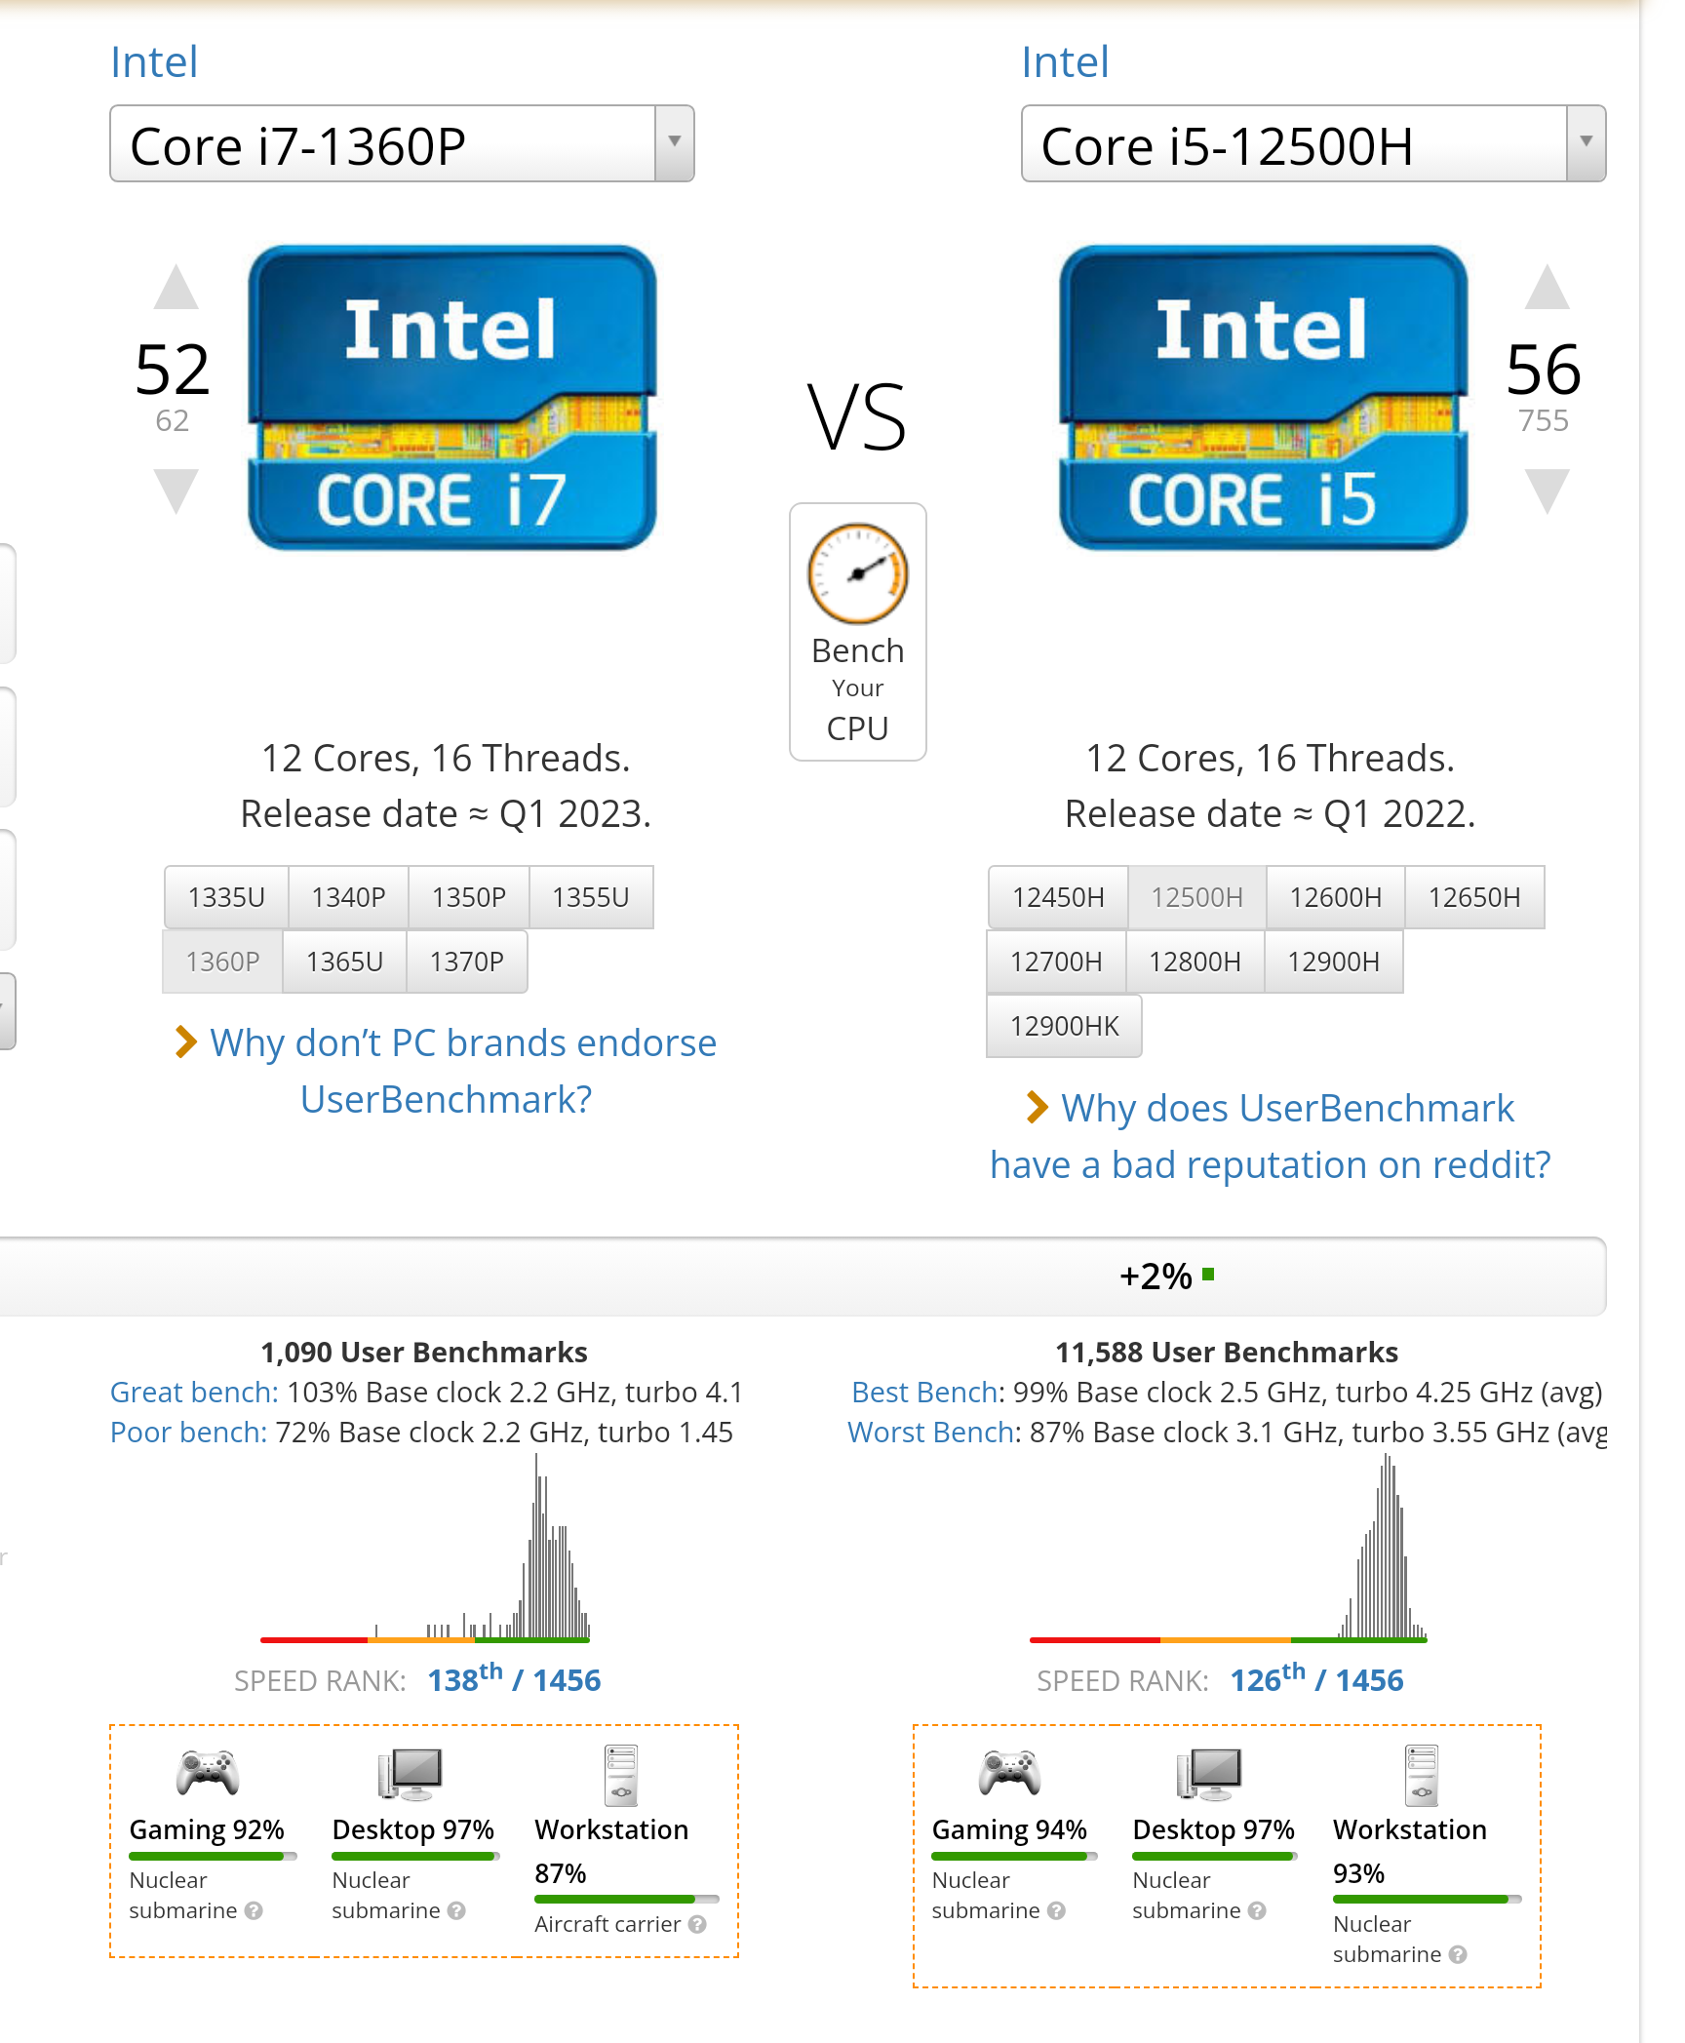
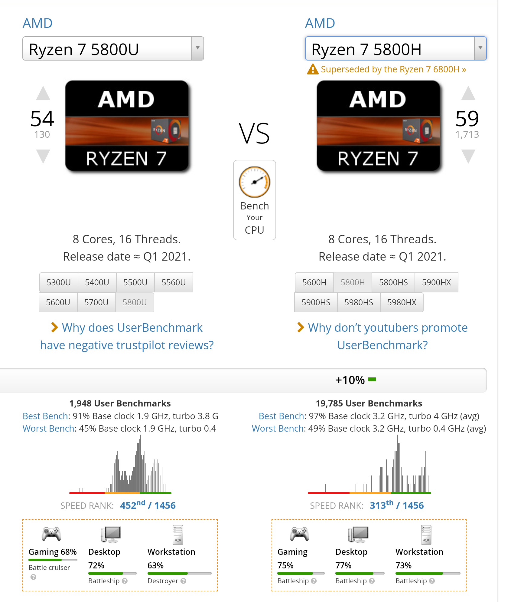

Slide 18
You might be hoping to see RAM next don’t you? Heehehehehehhehe, Next is..

Slide 19
LETS HAVE A QUIZ FIRST
WHICH PROCESSOR SHOULD PERFORM BETTER IN HIGH WORKLOAD?
RYZEN 5800U or
RYZEN 5800H?

Slide 20
Component that you need the most
GPU

Slide 21
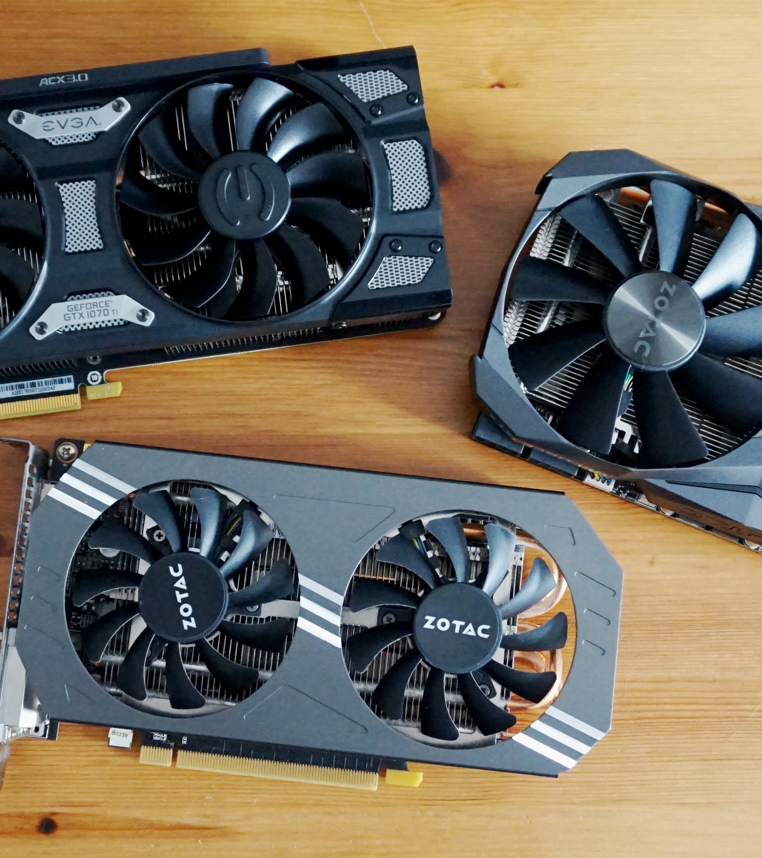
What to know about GPUs?
Right Guess, The price
Their generation
Their Architecture
AMD vs Nvidia (Intel is just getting started.)
VRAM
CPU
TGP

Slide 22
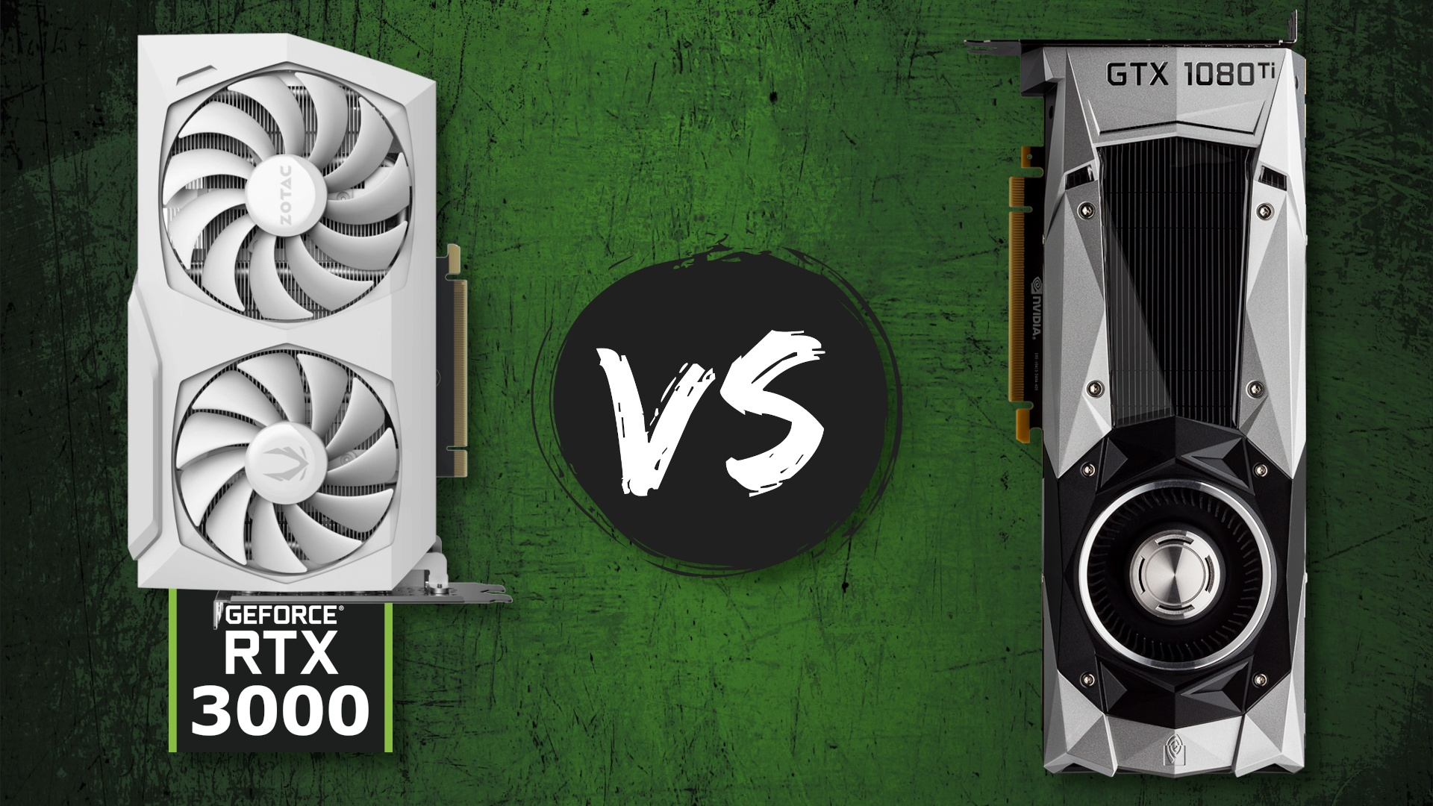
Generation
Each generation GPU improves a lot
Performance
Power Consumption
Capabilities (FSR, Ray Tracing, etc)
More improvement than CPU per generation

Slide 23
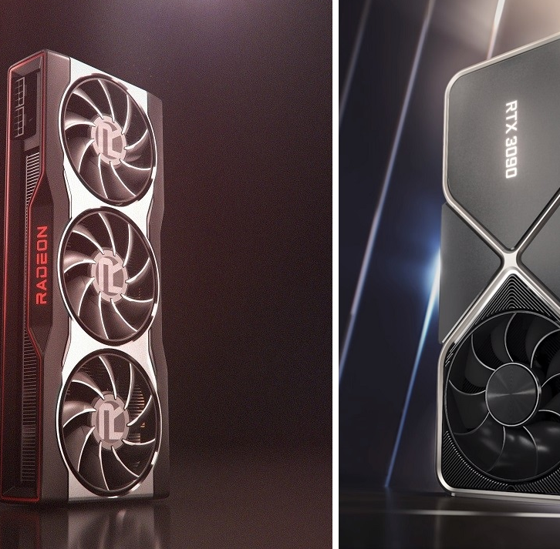
NVIDIA vs AMD
Keep intel GPUs side for now.
In present
AMD -> More VRAM-> Combined with AMD CPU can give a good advantage -> Technologies like SAM, FSRR, etc.-> Cheaper in budget and mid-range sector in US.
NVIDIA -> Better availability-> Better support on different OS-> Cheaper in Nepal -> Better for more technical works (AI / ML, scientific simulation) -> Better Ray Tracing -> DLSS and other technologies (Reflex, Shield, etc.)
Answer: Prefer Nvidia if you are in Nepal. It depends if you are in America.

Slide 24
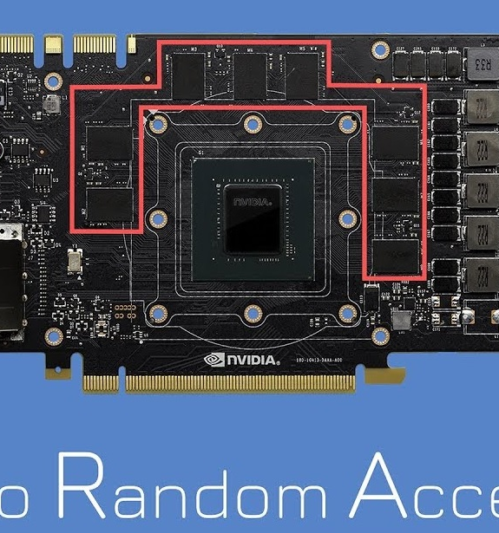
VRAM (Video RAM)
Like RAM but used for video processing
Less VRAM -> no way to use the app
4gB should be a minimum
For games, for multiple displays, for software like Etabs, Matlab, for everything

Slide 25
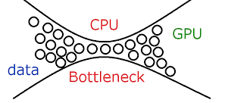

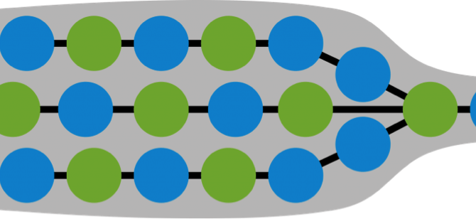
CPU
Yes, now let me introduce you all to an important term. BOTTLENECK
When one component is so slow that other faster components suffer and have to wait for that slow component. Like me in every group project and teamwork.

Slide 26
Practical Time
Benchmark Test
Gaming Test
3d render Test
Browsing Test

Slide 27
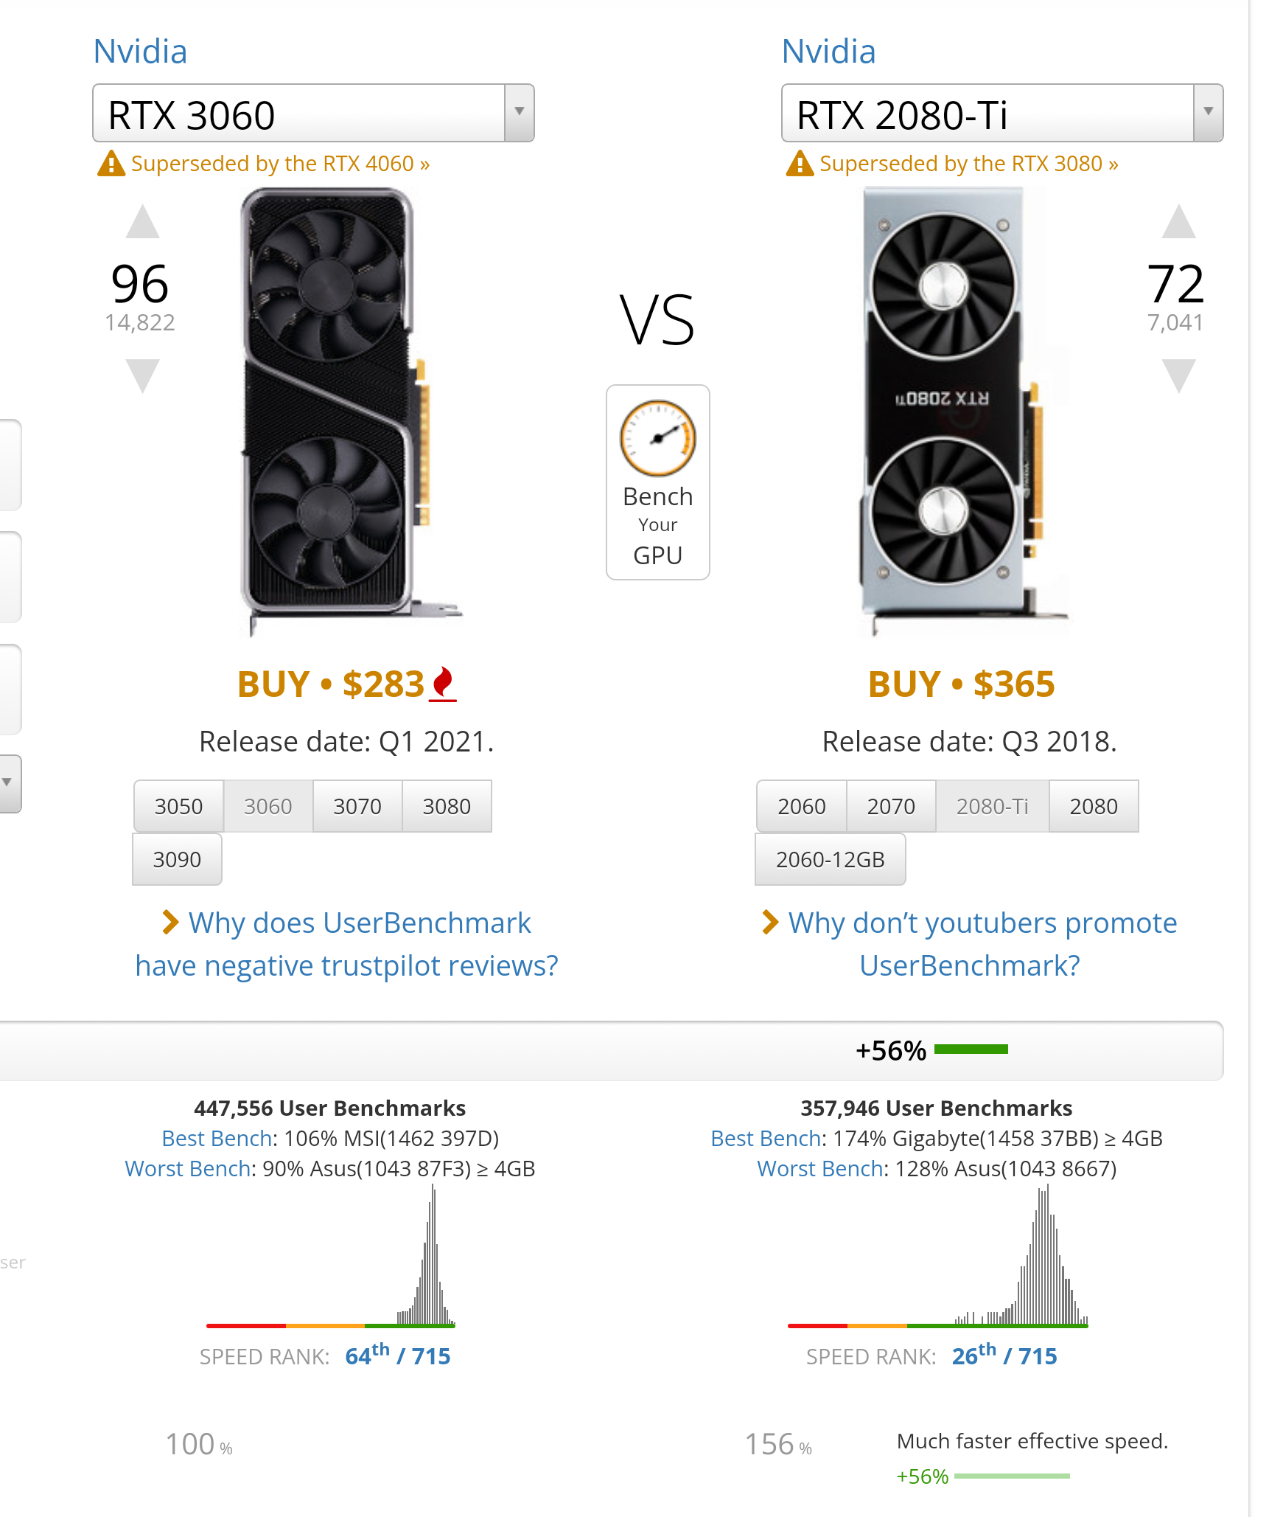
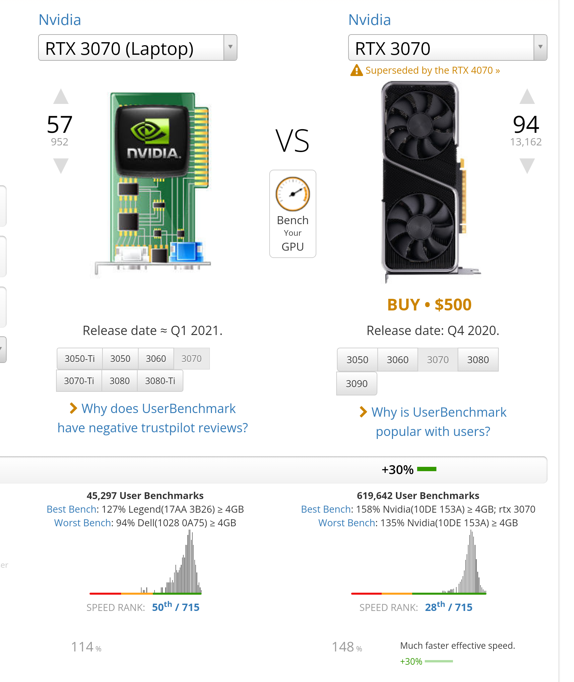

Slide 28
GPU IS MOST IMPORTANT FOR WHICH OF THESE APPLICATIONS
WEB DEVELOPMENT
BROWSING
WATCHING MOVIES
GAMING

Slide 29
What is the latest generation of Intel Processors available in Nepal?
15th generation (Arrow Lake)
14th generation (Meteor Lake)
13th generation (Raptor Lake)
12th generation (Alder Lake)

Slide 30
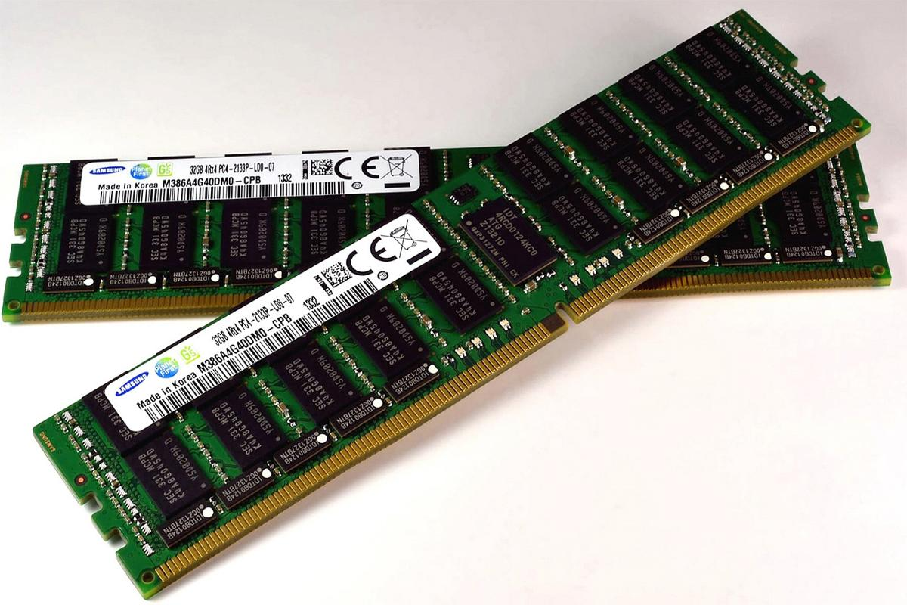
Well, Now lets go RAM
RAM

Slide 31
What to look for?
Price 😅
DDR version
How many GB?
Frequency
X8 or x16?
(single, dual, quad ) Channel

Slide 32
DDR (double data rate)
>= DDR3
DDR4 or DDR5 really recommended if you can afford

Slide 33
How much?
Depends on your task
More VMs more RAM
More tabs more RAM
Graphics and other creativity load more RAM
More multitasking more RAM
Newer AAA games more RAM
How much is generally good? (8gb or more. 16gb is preferred if you have the budget)
If you can, purchase devices with expandable memory

Slide 34
Frequency
RAM speed
DDR3 max frequency is 1600Mhz. DDR4 has 3200Mhz
If buying DDR4, try going >2666Mhz
DDR5 (4800-5600)Mhz

Slide 35
Rank (X8 or x16)? (Very nerdy)
Lower the number the better.
Same company ram with same gb same frequency will show noticeable improvement if x8 instead of x16.

Slide 36
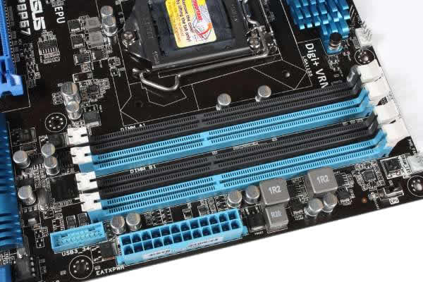
Channel
What is channel?
Try for at least dual channel.

Slide 37
Practical Time
Multi-tasking
Editing High-Res Photo/Video

Slide 38
UPGRADING FROM 16GB TO 64GB OF RAM IMPROVES YOUR FPS IN GTA 5 BY?
< 2 TIMES
GREATER THAN 2 TIMES
GREATER THAN 4 TIMES

Slide 39
Time for
STORAGE

Slide 40
You might already know much of this.
Price
How much do you need
Which? (HDD vs SSD)
Which 2? (Nvme vs Sata)

Slide 41
HDD vs SSD
HDD -> photos, videos, and books and other backup items. (if less budget, everything except the windows boot drive in HDD)
SSD -> things you interact with most. OS, Softwares, etc.
SSD -> 4x+ faster than HDD
Tradeoff : Price vs Performance

Slide 42
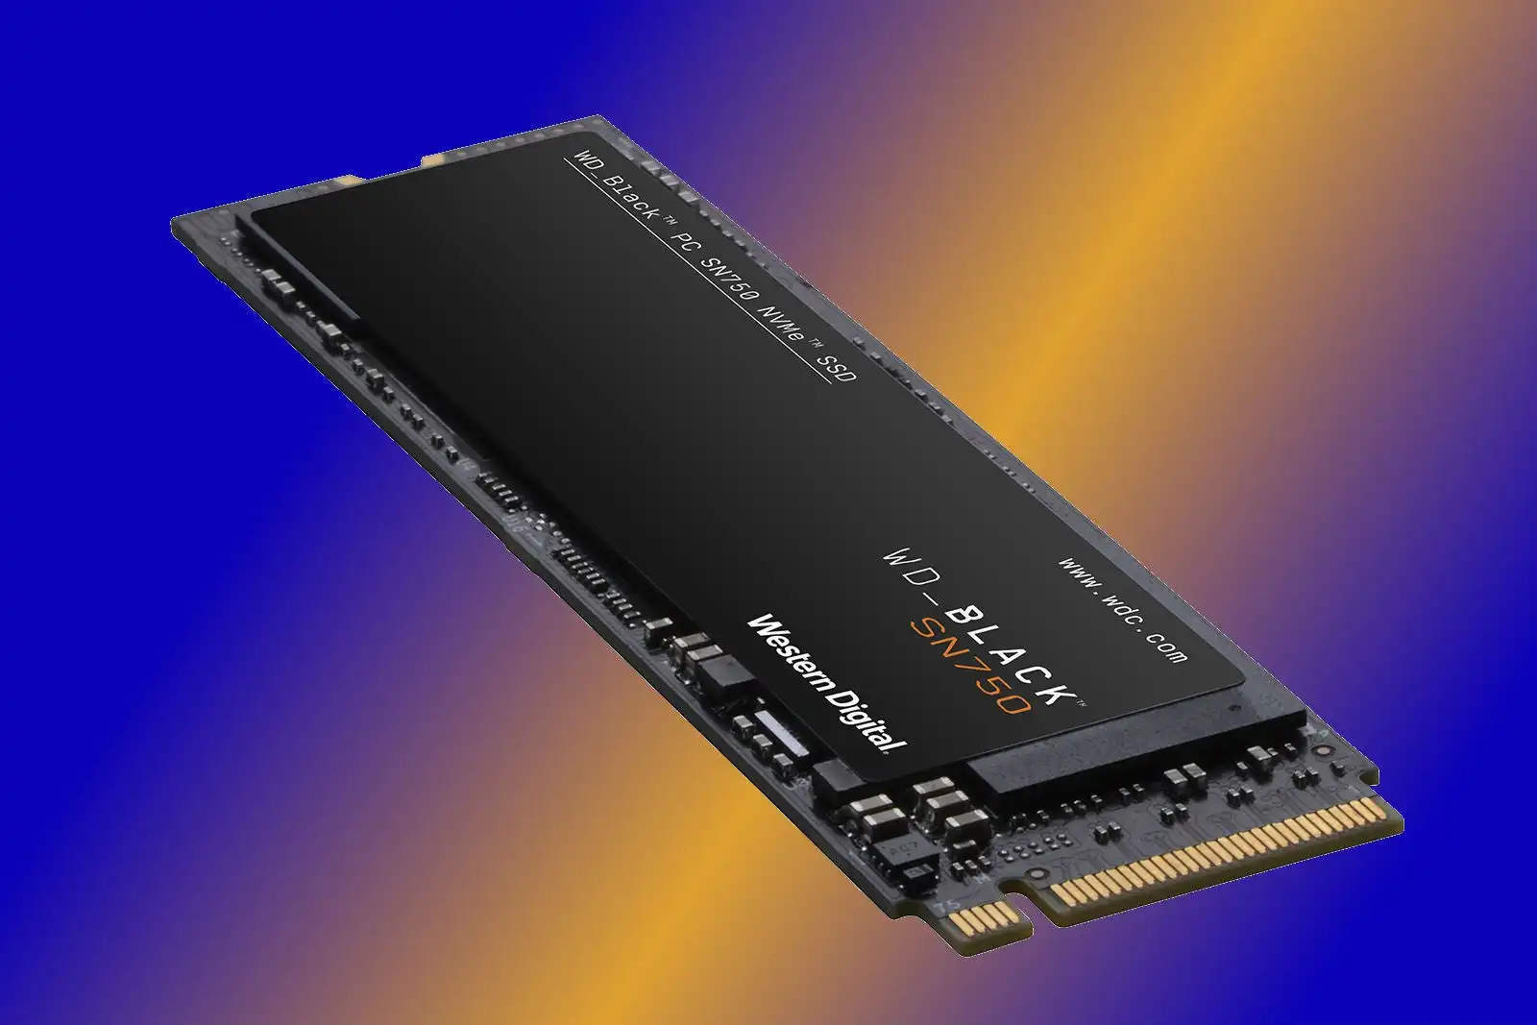
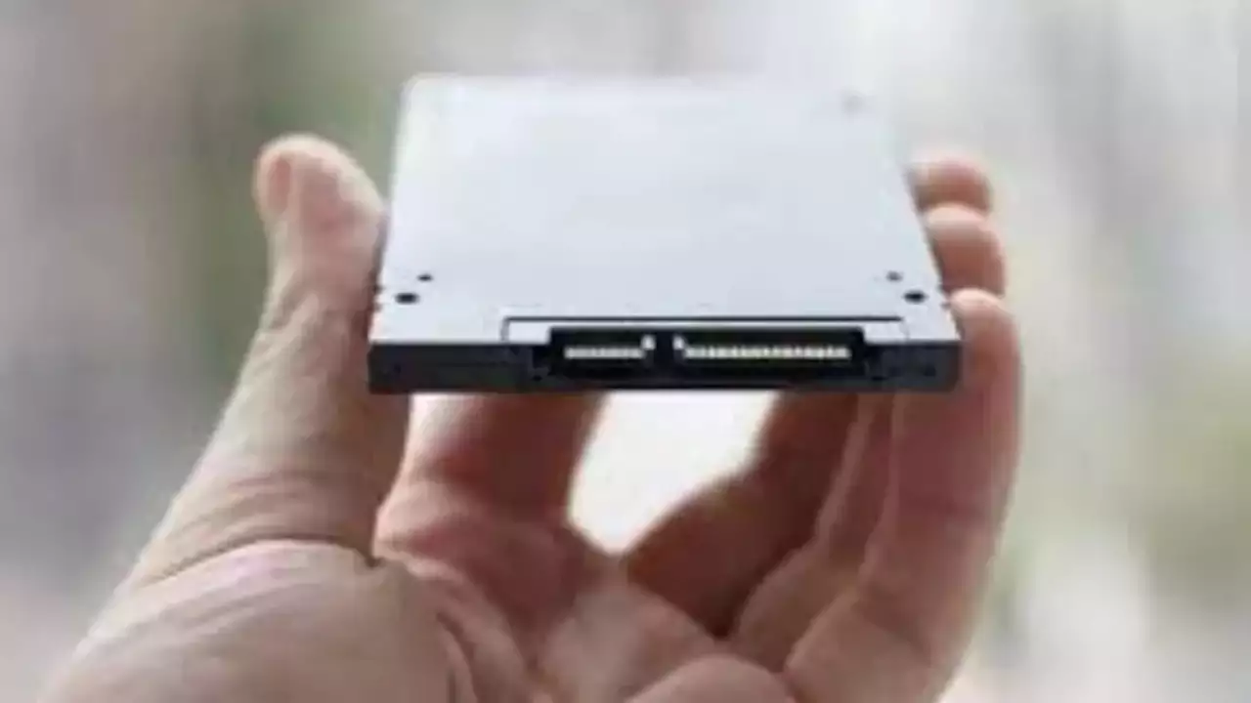
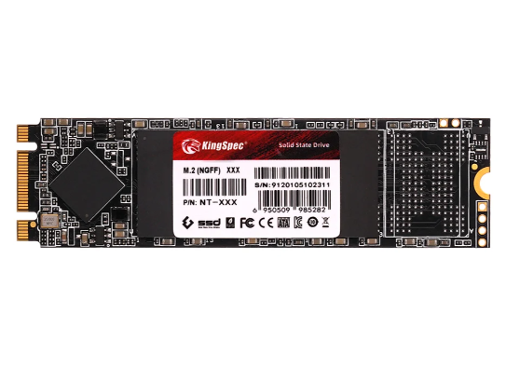
NVMe vs Sata
Comes down to price. If upto 5/4th the Sata price, try NVMe. NVME PCI gen 2 90x faster than HDD
SATA
NVME

Slide 43
How much do you need?
I don’t know. Only you can answer this.
Just buy something with extra additional ports if you don’t want to get in the mess of replacing the old one.
For normal usage, 512 GB should be enough

Slide 44
Practical Time
HDD vs SSD load Times

Slide 45
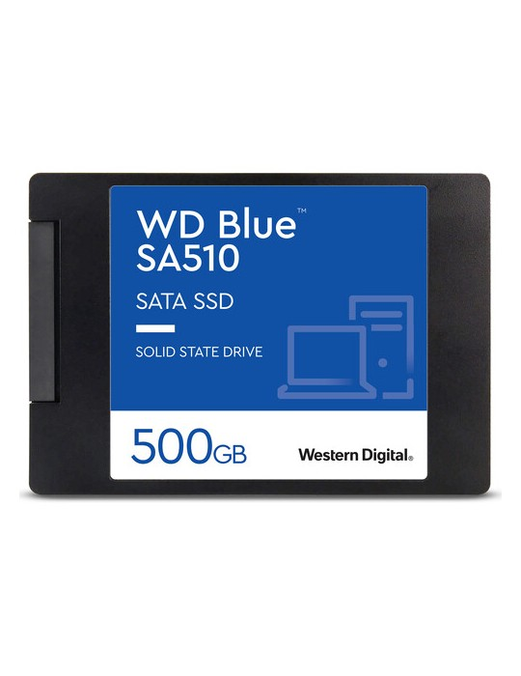
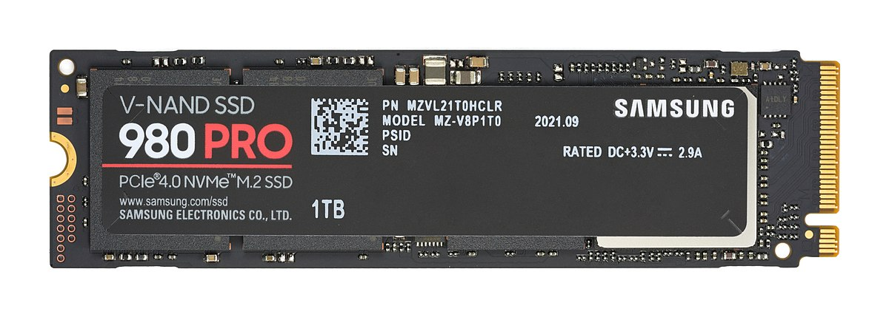
WHICH SSD IS faster?
A B

Slide 46
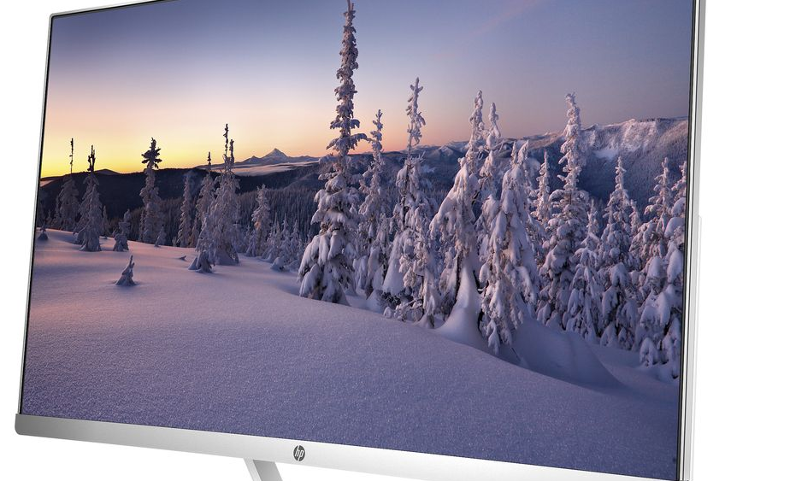
It’s the underdog’s time now
DISPLAY

Slide 47

It quite frustrates me when people start caring more about mobile’s refresh rate than Laptops’
Panel Type
Refresh Rate
Brightness control
Color coverage
Aspect Ratio
Glossy vs Matte

Slide 48


Color Accuracy
How accurately does the display produce the color it is supposed to?
Display can be inaccurate even if it has a high color gamut.

Slide 49

Color Gamut
How much color display can actually show/ produce.
Many measures (scales) (DCI P3, srgb, Adobe rgb, NTSC, etc)
Depends on how professional you are.
If you can, get at least ~100% srgb ~72% NTSC

Slide 50
Color Accuracy
How accurately does the display produce the color it is supposed to?
Display can be inaccurate even if it has a high color gamut.

Slide 51
Brightness
Why do we need?
Measured in nits or cd/m²
At least 250nits for Matte type and 300 nits for glossy

Slide 52
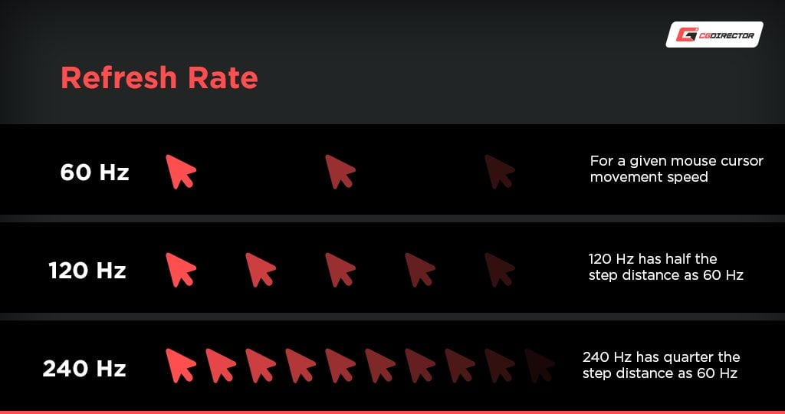
What is Refresh Rate?
For non gamers >=60Hz. 120Hz or more is preferred for gamers

Slide 53
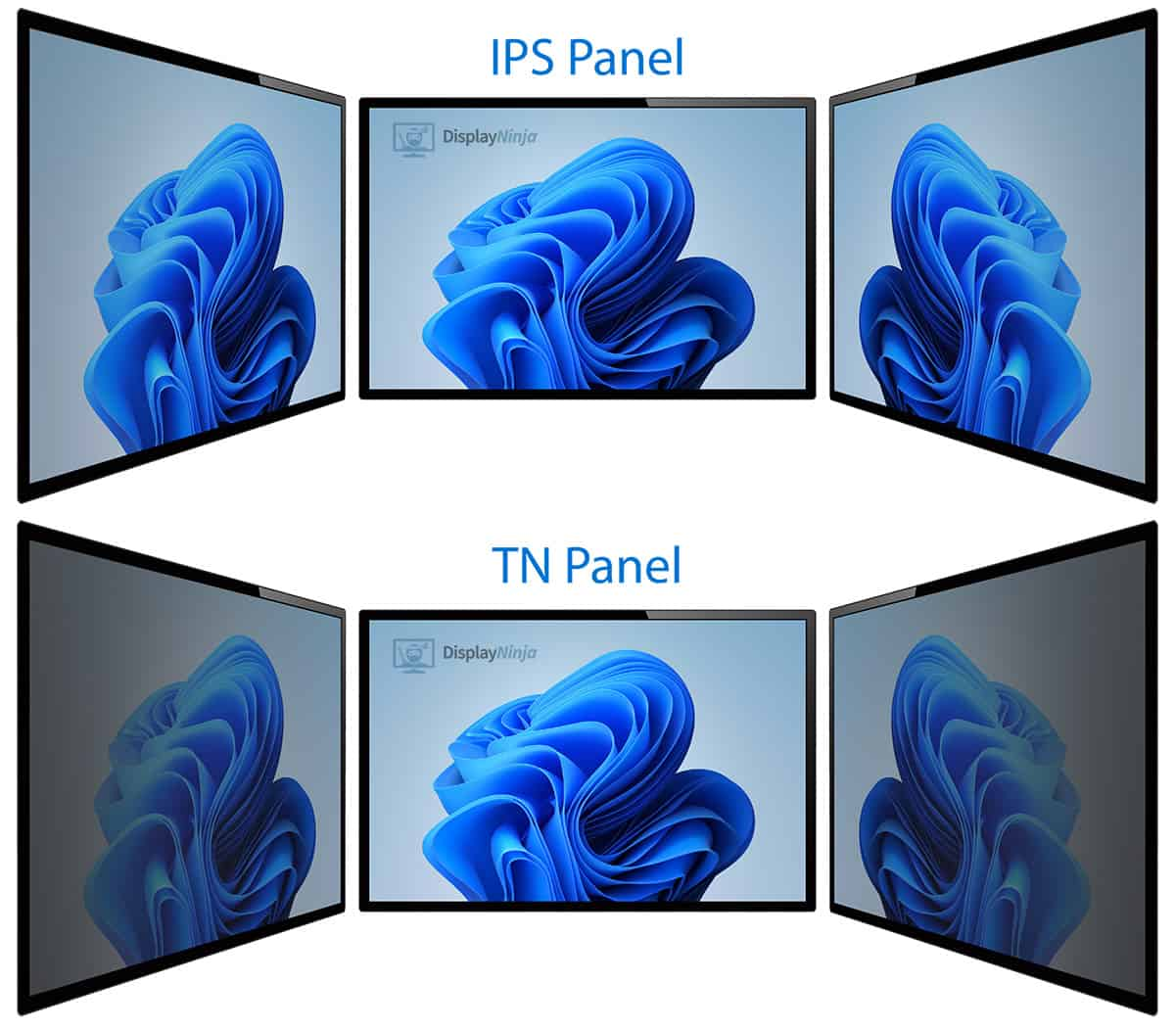

Panel Type
TN
(Not recommended)
IPS
Micro-LED
OLED

Slide 54
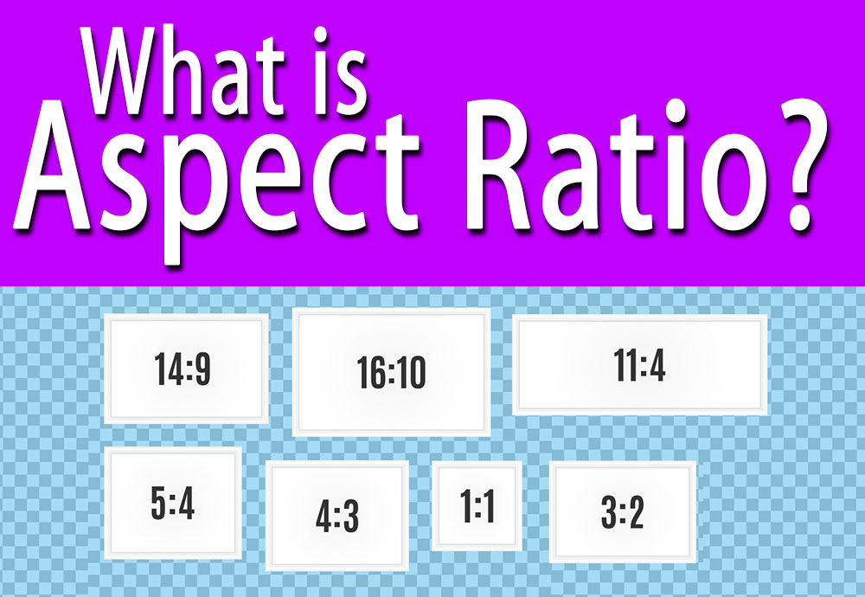
Aspect ratio
Ratio of the length of the screen to the height of the screen
For most people, 16:9 is fine. Also, it’s what you will mostly find.
For creativity, 16:10 or 4:3 is recommended

Slide 55

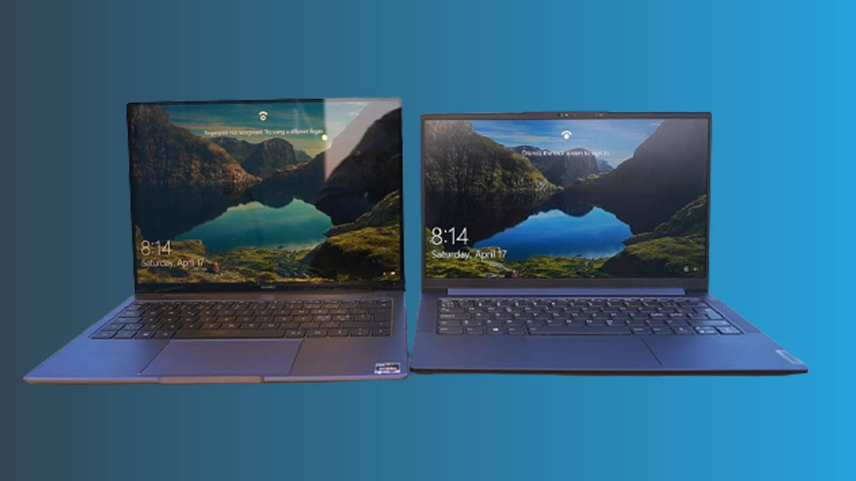
Matte vs Glossy
Both have their advantages

Slide 56
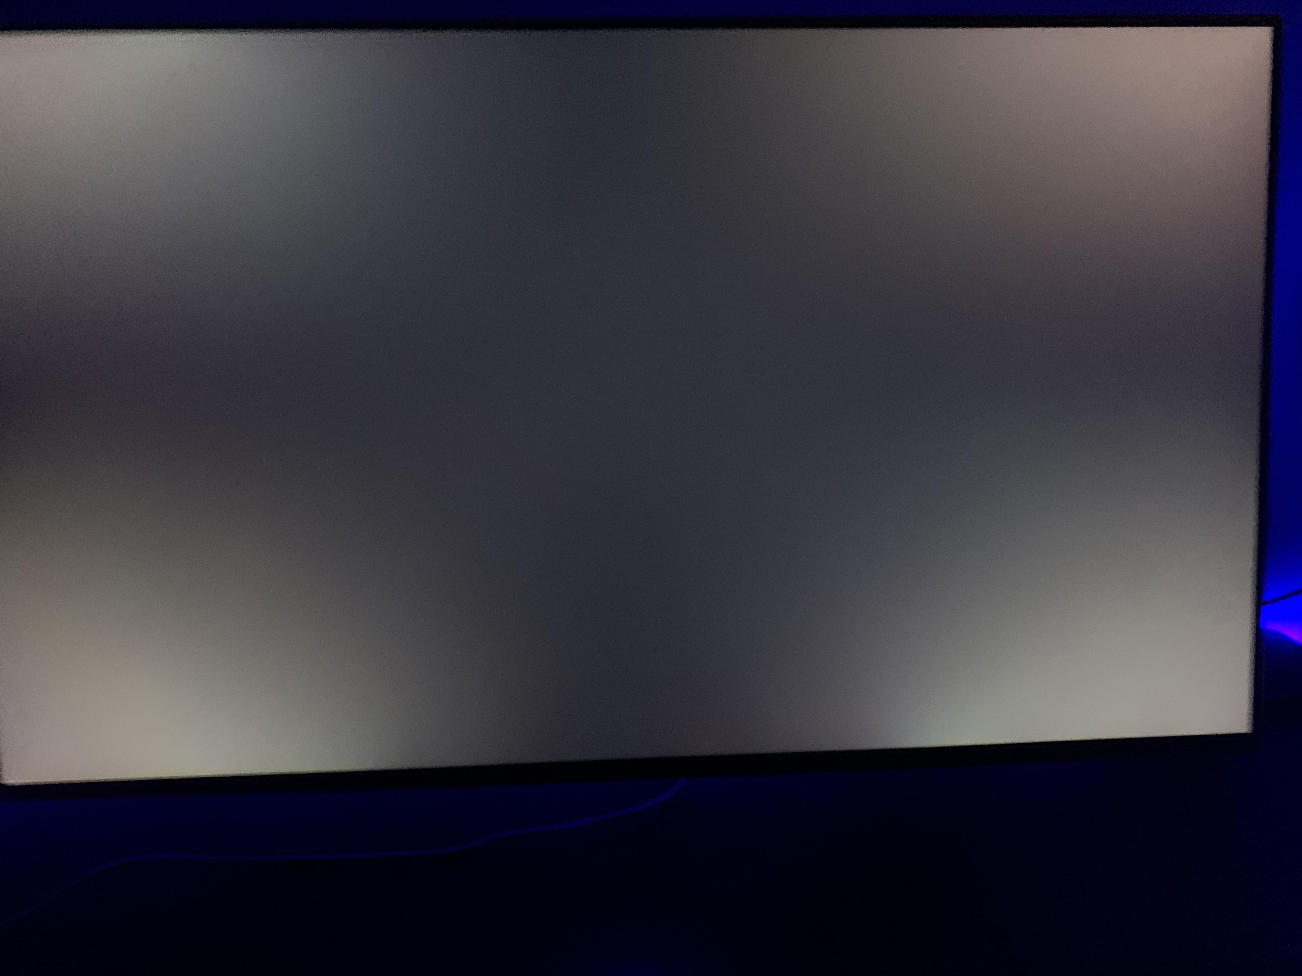
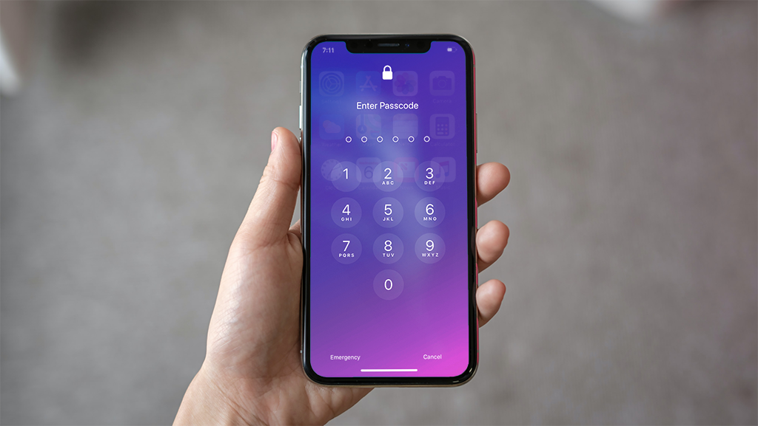
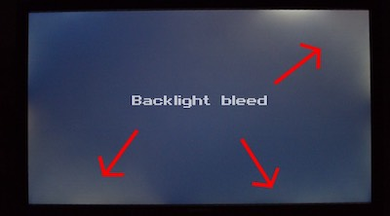

Issues in Display
Backlight Bleed
IPS glow
Pixel Burn
Pixel defect
Backlight Bleed
Pixel Burn
Pixel Defect

Slide 57
Practical Time
Different Refresh Rates
Different panels and their viewing angles
Different panels and their color accuracy
Browsing Test
Matte vs Glossy

Slide 58
IN WHICH UNIT IS USUALLY BRIGHTNESS EXPRESSED IN?
% (99% COVERAGE)
RATIO (16:10)
ms (23ms)
Hz (120Hz)
NITS (500 nits)

Slide 59

Under rated things

Slide 60
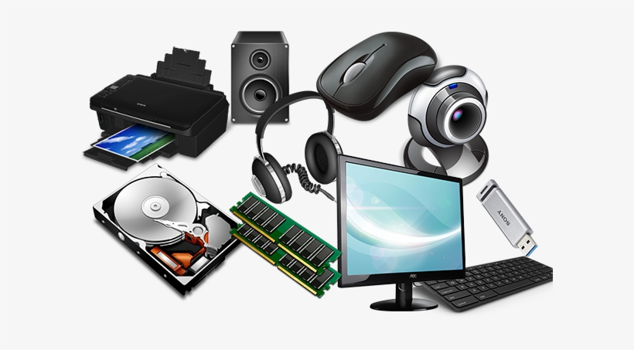
What are included in here?
Keyboard (mechanical or not)
Mouse (how many buttons, how ergonomic, weight and size)
Speakers (ports)
Connectivity (what you need)
OS (hardware support)

Slide 61
Practical Time
Membrane vs Mechanical keyboard
Different mouses

Slide 62
Practical Time
Membrane vs Mechanical keyboard
Different mouses
3d render Test
Browsing Test

Slide 63

Laptop exclusives

Slide 64
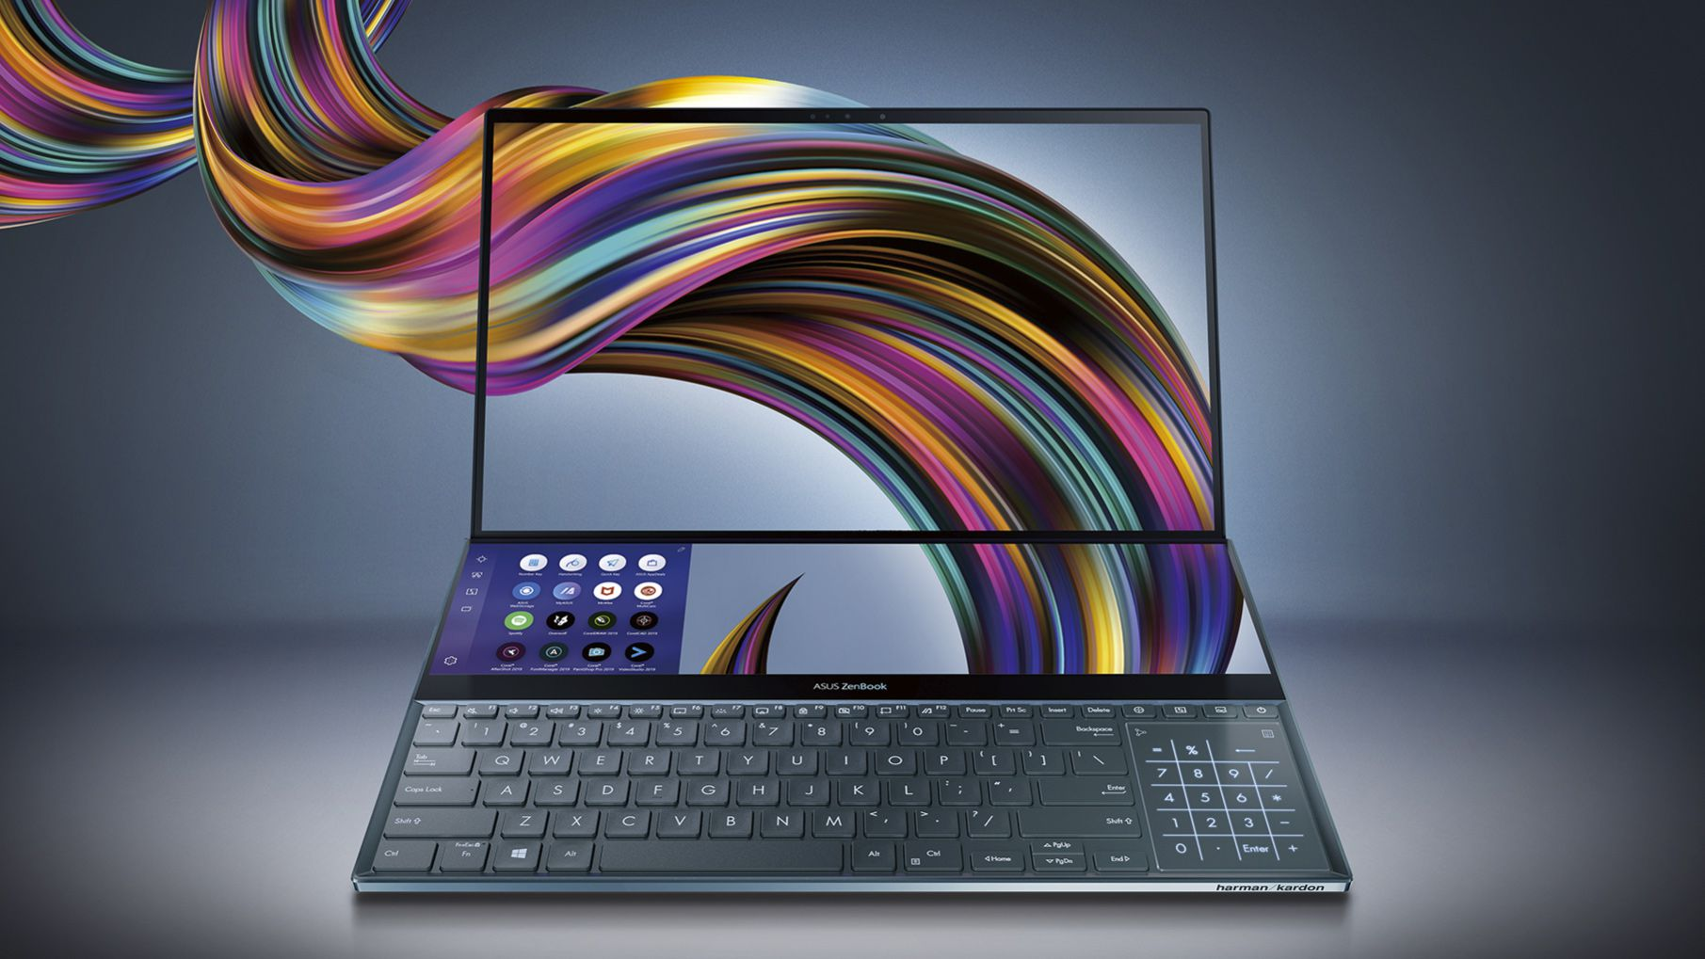
What’s about Laptos that Desktops don’t have?
Battery
Portability (size and weight)
Thermal solution
Upgradability
X-tra features (touch screen, dual screen, scrolls, webcam, etc)
USB-C Charging
MUX switch

Slide 65

Battery
Measured on Wh.
Higher is better
Depends too much in other components used
Depends on the applications used
Only component that actually degrades significantly
Replacable for most models
4-5 hours should be enough on light to medium when not used during travel
8-9 hours for other people who don’t like to charge much.

Slide 66
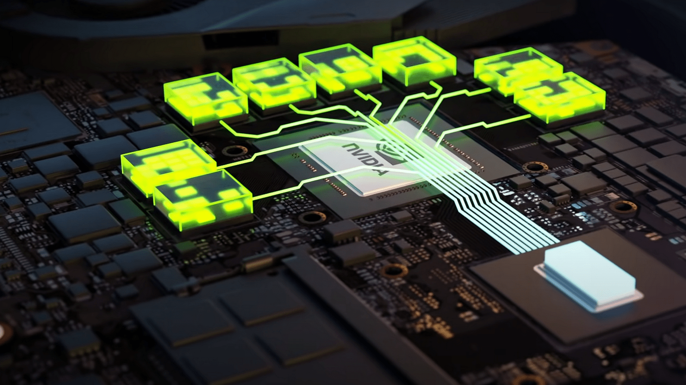
TGP
Measured in Watts (Generally 70W-150W)
Maximum wattage available to CPUs and GPUs. (GPUs TGP matters for Nvidia RTX 30 series)
Something that started only 2 years (RTX 30 series GPUs)
Higher is better
See the specs to check the full TGP of the GPU.

Slide 67
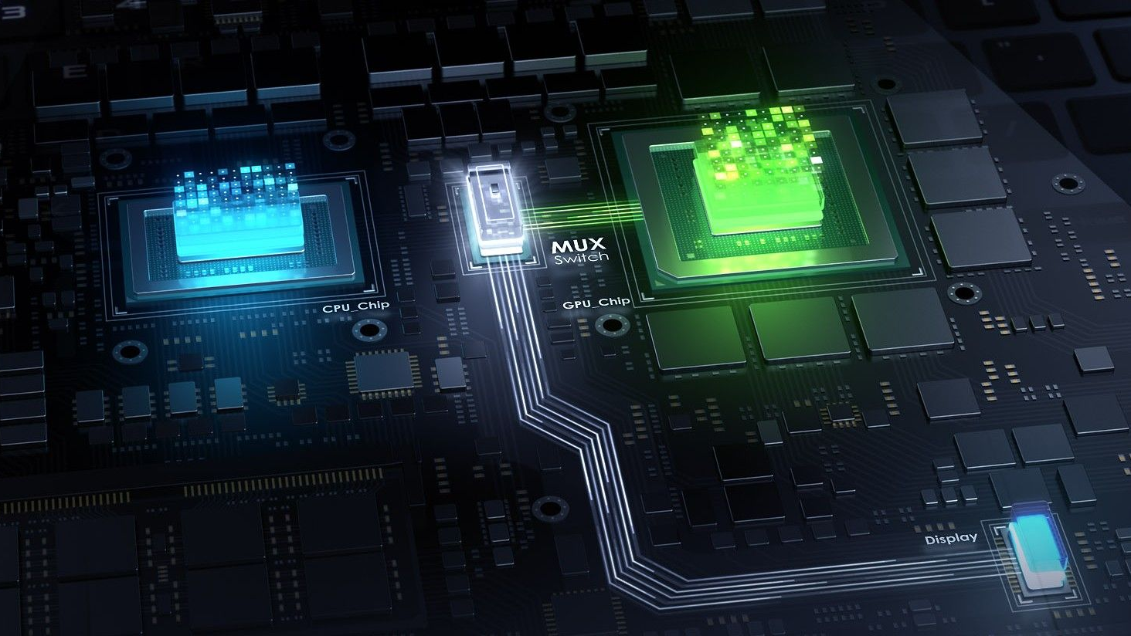
MUX switch
Ability to turn on only the Main GPU (NVIDIA GPU in your case) for maximum performance.
Most cheap laptops don’t have it.
Tradeoff after switching to DGPU mode = more battery consumption

Slide 68
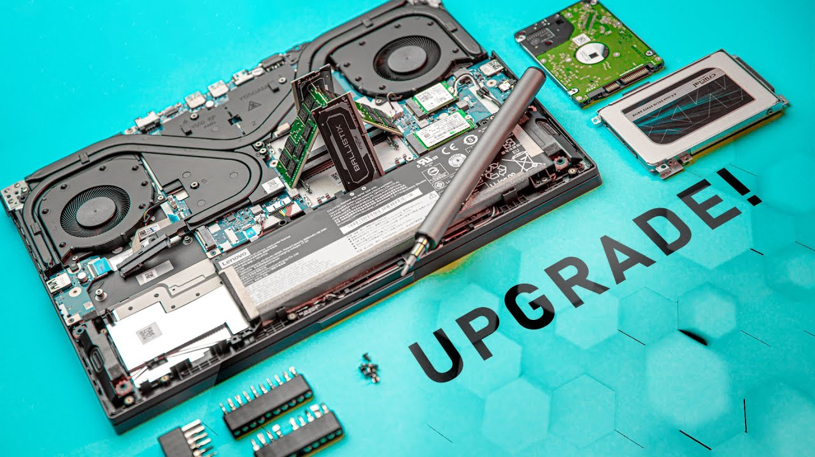
Upgradability
RAMs and SSDs should be generally upgradable for future-proofing.
Hardly any laptops have replaceable CPUs and GPUs.
Battery is internal in most modern laptops but can be upgraded.

Slide 69

Portability
How portable do you need?
Size vs Performance Tradeoff
Size vs Battery Tradeoff
Size vs Speaker Tradeoff
Size vs Robustness Tradeoff
Size and weight go hand in hand

Slide 70

Thermals

Slide 71
Practical Time
Portability
Upgradability
Battery
Charging

Slide 72
WHICH IMPORTANT COMPONENT WE MISSED?
OPEN ANSWERS. UNTIL THE RIGHT ONE IS ANSWERED.
HINT : IT IS COLORFUL

Slide 73

Waittttttt.. The most important thing still remainsssssssssssssss..

Slide 74
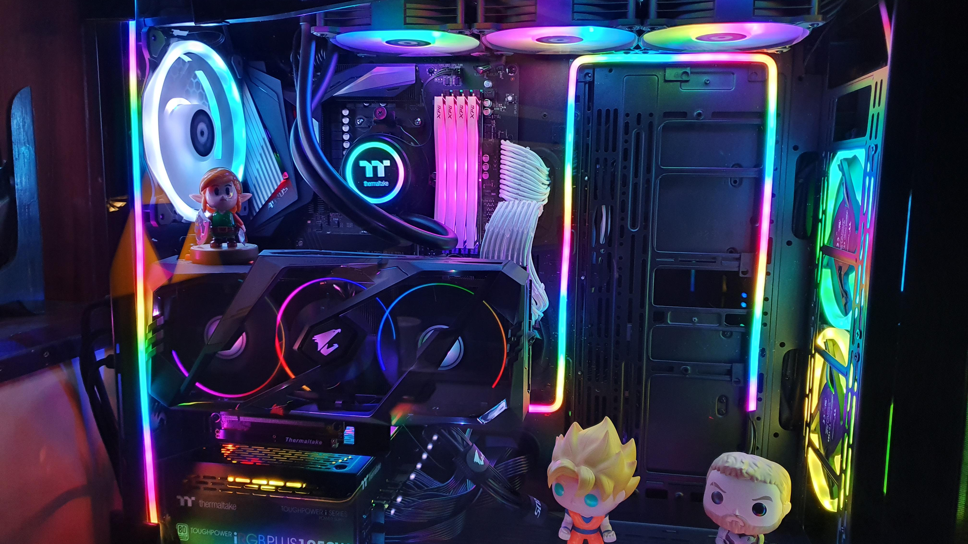
RGB

Slide 75
QNA TIME

Slide 76
What is the latest generation of Intel Processors available in Nepal?
15th generation (Arrow Lake)
14th generation (Meteor Lake)
13th generation (Raptor Lake)
12th generation (Alder Lake)

Slide 77
Which of these Memory is usually not upgradable in nature?
RAM
SSD
VRAM
Virtual Memory

Slide 78
Which of these has a new generation after the longest time?
RAM (DDR)
CPU (Generation)
GPU (Generation)

Slide 79
Buying 2nd hand for which of these is a worse option?
RAM
CPU
Hard Disk

Slide 80
Select the Best laptop for playing good graphics games assuming all laptops cost the same
10500H, RTX 3090 laptop, 16GB RAM, 1TB SSD
13500H, RTX 3080, 16GB RAM, 1TB SSD
13500H, RTX 4080, 8GB RAM, 2TB SSD

Slide 81
Why is generation important when choosing a CPU?
A) It determines the physical size of the CPU
B) It indicates the manufacturing date of the CPU
C) It reflects advancements in technology and performance
D) It shows the CPU's compatibility with all types of RAM

Slide 82
How does CPU frequency impact a computer's performance?
Higher frequency always results in longer battery life
Higher frequency means more powerful graphics
Higher frequency generally means faster processing speeds
Higher frequency reduces the need for RAM

Slide 83
How does the capacity of RAM affect a computer's performance?
A) Higher capacity allows more applications to run simultaneously
B) Higher capacity always increases battery life
C) Higher capacity reduces the need for a GPU
D) Higher capacity improves internet speed

Slide 84
What is the benefit of having dual-channel RAM?
A) Increased data transfer rates
B) Reduced power consumption
C) Decreased CPU usage
D) More RAM capacity

Slide 85
How does storage capacity influence a computer's usability?
A) More capacity allows for more data and applications to be stored
B) More capacity always increases battery life
C) More capacity always improve the speed of computer
D) More capacity enhances the fps in games

Slide 86
How much refresh rate is enough for most general people for smooth experience?
40Hz
60Hz
120Hz
360Hz

Slide 87
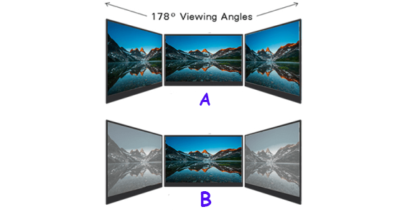
Identify Panel types of A and B
A – IPS, B – TN
A – IPS, B - OLED
A – TN, B - IPS
A – IPS, B - UPS

Slide 88
Which factor is NOT much crucial when choosing a keyboard for a PC setup?
A) Key switch type
B) Backlighting options
C) Year of Manufacture
D) Ergonomic design

Slide 89
Thank Youuuuu

